Slide 1

Microapps
Breaking the mobile app monolith
Nischal Y
Co-Founder, Eloha.io
Principal Software Engineer, Progress
@nischalsrinivas

Slide 2
Agenda
Evolution of application architecture.
Microapps What, Why and How?
Microapps in Mobile and Web.
Notes:
Although we as consumers live and breath by mobile apps in out daily lives, the adoption of mobile apps in enterprises is still low
And employees for the most part still rely on webapps to access business systems
And although enterprises realise the promise of mobility, they are not able to keepup with demands for mobile apps,

Slide 3
Frontend
Frontend
Backend
The Monolith
Backend
Database
Database

Slide 4
Frontend
Frontend Team
Frontend
Backend
Backend
Backend & Devops
Database
Database

Slide 5
Frontend
Frontend Team
Frontend
Aggregation Layer
Backend
Backend
Micro Services
Micro Services
Micro Services
Micro Services
Database
Database

Slide 6
Frontend Team
Aggregation Layer
Micro Services
Micro Services
Micro Services
Micro Services
Micro Services
Micro Services
Micro Services
Micro Services

Slide 7
Disadvantage of Monolithic frontends
Agenda
More pressure on frontend teams
Teams cannot work independently
Project has to be tested as a whole and changing one feature can potentially break the other
Cost of change is huge
Offload integration tasks to backend
Separate backend and frontend teams
Notes:
More pressure on frontend teams
Teams cannot work independently
As frontend has to be deployed in one go
Project has to be tested as a whole and changing one feature can potentially break the other
Cost of change is huge
Offload integration tasks to backend
Integrate and submit pull requests
Separate backend and frontend teams

Slide 8
Vertical Decomposition
Team A
Team B
Team C
Team D
Frontend
Backend
Search feature
Product info
Cart/Checkout
Recommendation
Database

Slide 9

Micro Frontends
Notes:
It is partly solved by micro frontends or composite frontends

Slide 10

Monolithic UI consuming microservices
Monolithic UI
Microservices UI
Microservice 1
Web API Container
Data
Data
Microservice 1
Web API Container
Data
Web API Container
Microservice 1
Web API Container

Slide 11
Composite UI generated by microservices
Composite UI
Backend Microservices
UI Composition
Microservice 1
UI Composition
Microservice 3
UI Composition
Microservice 2
Other Internal
Microservices
UI Composition
Microservice 2
UI Composition
Microservice 2

Slide 12
Custom Elements
Shadow DOM
ES Modules
HTML Template
Web
Components
Notes:
Web components are a set of web platform APIs that allow you to create new custom, reusable, encapsulated HTML tags
Four main specifications:
Custom Elements
Shadow DOM
ES Modules
HTML Template

Slide 13
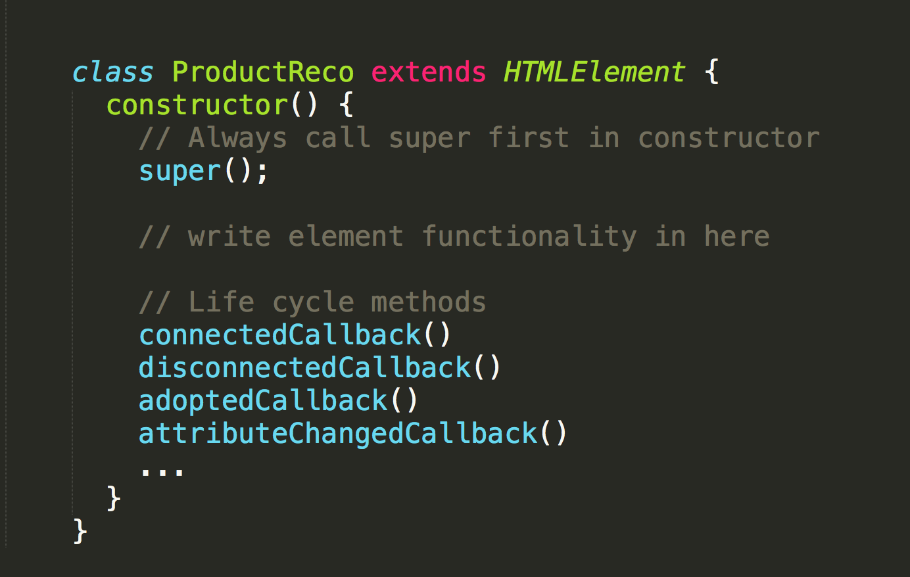
Creating a custom element
Notes:
Also show that they can use whatever framework they want inside here

Slide 14
Creating a custom element
Notes:
Also show that they can use whatever framework they want inside here

Slide 15
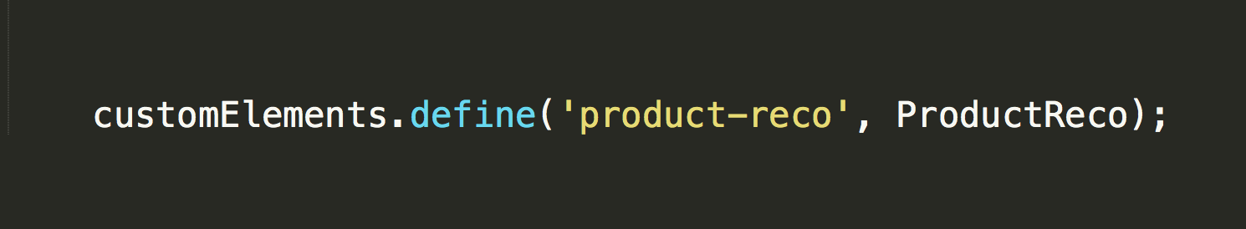
Registering Custom Element
Notes:
Also show that they can use whatever framework they want inside here

Slide 16
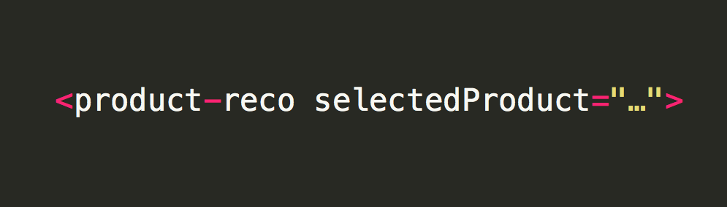
Using Custom Tags
Notes:
Also show that they can use whatever framework they want inside here

Slide 17
Vertical Decomposition
Team
Team
Team
Team
Frontend
Search feature
Product info
Cart/Checkout
Recommendation
Backend
Database

Slide 18

But what about mobiles?
Notes:
Just title with an image

Slide 19
Breaking frontend monolith with Microapps
Notes:
Microapps derives most of the fundamental concepts from micro frontends and infact can be applied to both Mobile and Web

Slide 20
What are microapps?
Single-Purpose
Cross-Platform
Singe Step
in a Workflow
Notes:
Microapps are single purpose cross platform applications that help accomplish a single step in a complex workflow.
For example if you take an HR system each feature can be broken down into a microapp, like timeoff, pay etc
Like any other application a microapp consists of an User interface and a microservice that serves as a backend.
Together they provide an adaptive user experience that lets user get in interact and get out with less friction.
But why do you need microapps when you have mobile apps that have been there for so long,
Lets have a comparision between the two to understand better

Slide 21


Notes:
This is the essensce of a microapp to be able to provide right information and tools to get the task done at right time.

Slide 22
Micro Interface
Microservice
Microapp

Slide 23
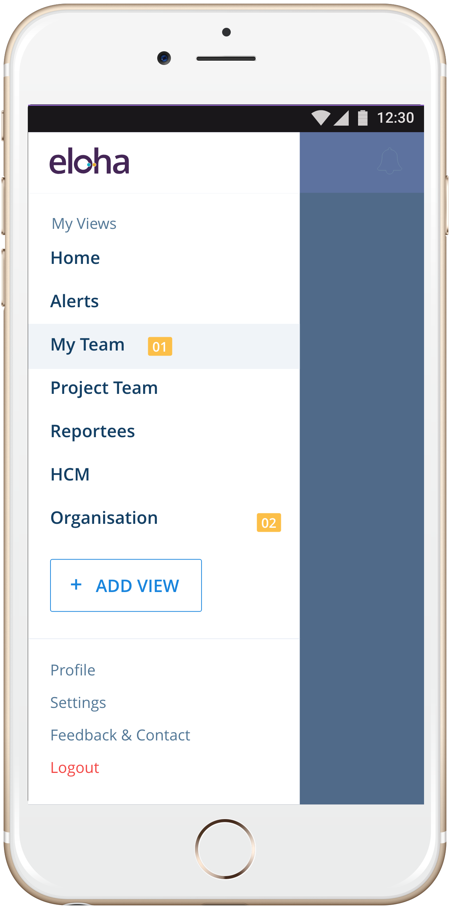
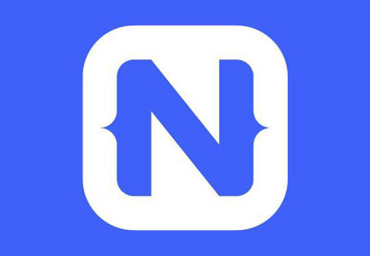
Microapp Container
Microapp
Microapp
Microapp
Native Container + Virtual Machine
OS
Notes:
Also add web container

Slide 24
How do they look

Slide 25
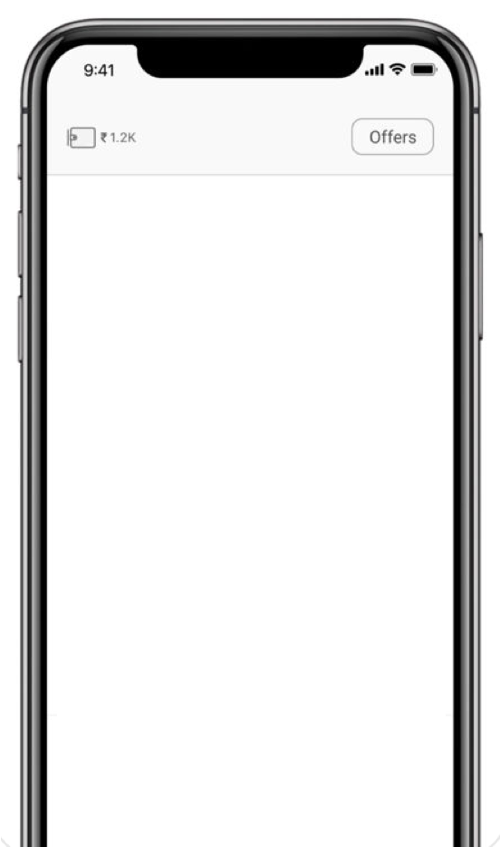
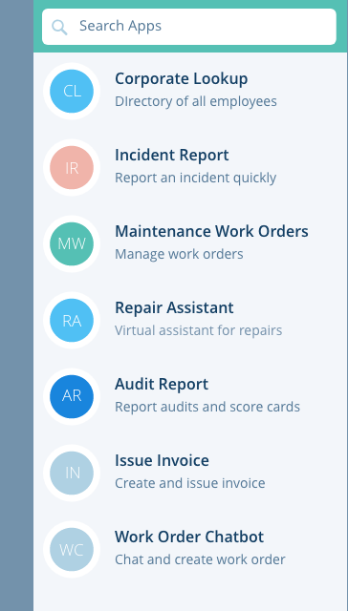
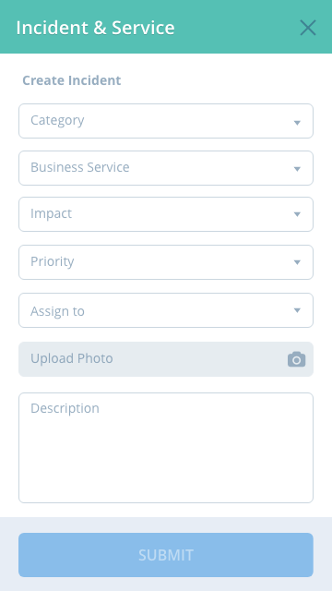
Catalogues

Slide 26
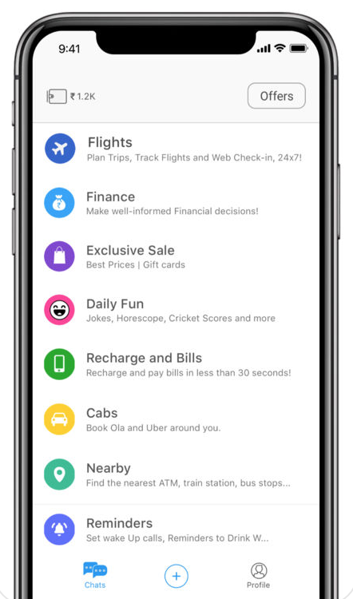
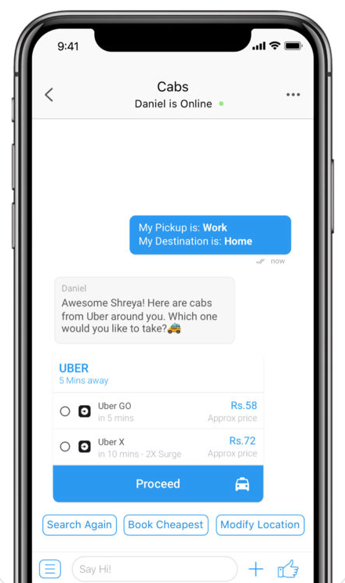
Conversational UI

Slide 27
Service Tickets
Open
Active
Closed
02
03
06
Widgets
08
33
Service Analytics

Slide 28


Hybrid

Slide 29
How are they published to container

Slide 30
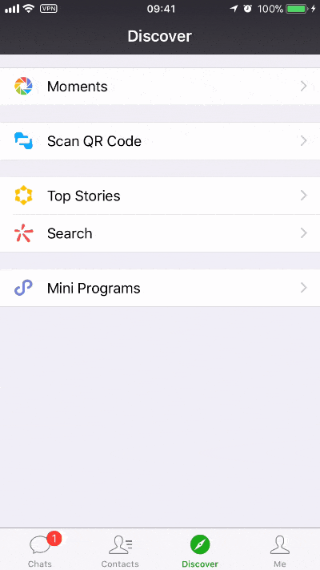
Discovery
(SEARCH)

Slide 31
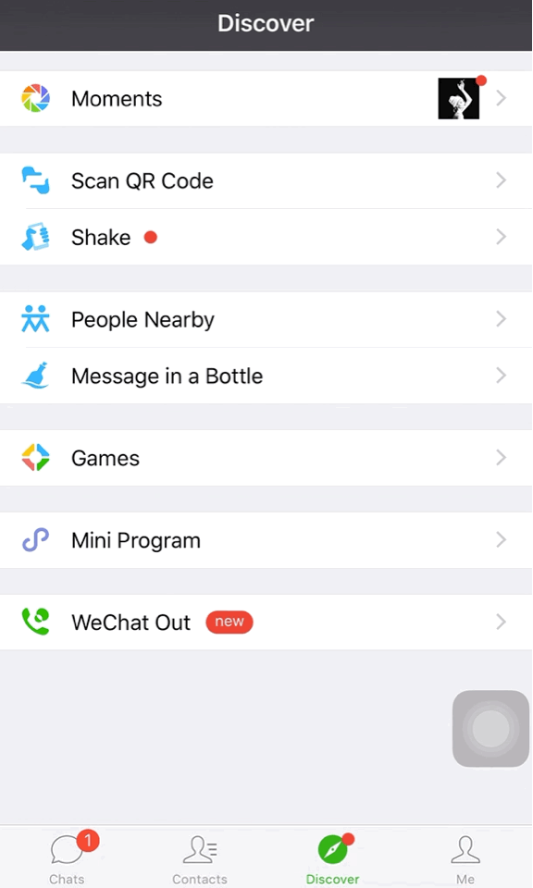
Discovery
(QR CODE)

Slide 32
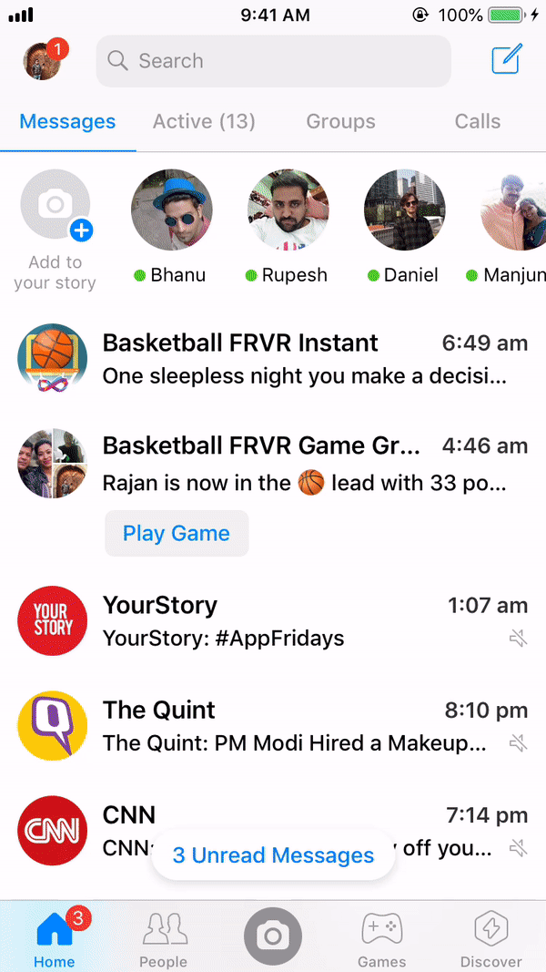
Executed on Demand

Slide 33
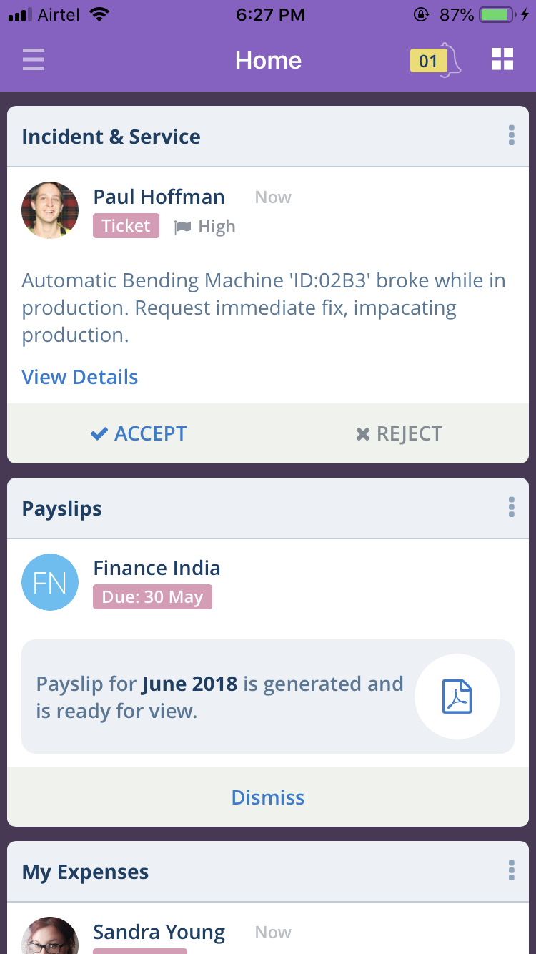

Notified when a new microapp is available
New Microapp available
My Expenses

Slide 34
WeChat how it changed commerce in china
( A Case Study )
Notes:
We chat app to the left and points to the right

Slide 35
Mini programs
In 1 year ~580,000 mini programs
980 million userbase
170 MAU for mini programs
Big brands are building mini programs
Public services, Utility etc
Order Taxi, Flights, Hotels, Movie tickets

Slide 36
How can you build microapps
Notes:
Mobile Container - React Native, NativeScript or Hybrid
Web Container - React, Vue, Angular etc webcomponents
Code sharing between mobile and web
Backend - build entire backed from scratch, IaaS providers
BaaS providers like Kinvey and firebase and build microapp services on top of it

Slide 37

Developer
Admin
Mobile
App
Microapp Registry
Code Sharing
Microservice A
Microservice B
Web
Microservice C
Containers
Microservices
Notes:
Mobile Container - React Native, NativeScript or Hybrid
Web Container - React, Vue, Angular etc webcomponents
Code sharing between mobile and web
Backend - build entire backed from scratch, IaaS providers
BaaS providers like Kinvey and firebase and build microapp services on top of it

Slide 38
Lets build a microapp
Notes:
Create a microapp (albeit from a template)
Test it on a container
And Publish it

Slide 39
Software architecture should never be a goal, but a means to an end.

Slide 40
Thank You!
@NischalSrinivas
Eloha.io
Eloha.io/webinar

Slide 41
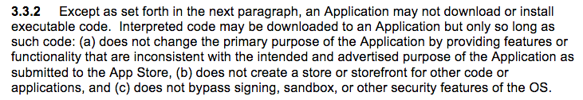
Notes:
No store/store fronts
Because Cordova apps are executed within a WebView, and React Native apps are executed within JavaScriptCore, from a technology perspective, these runtimes are unique in their ability to leverage dynamic code downloads according to the aforementioned Apple developer agreement.

